Slide 1
Data Science for Agentic AI
Mary Ann Mastri
April 21, 2026

Slide 2
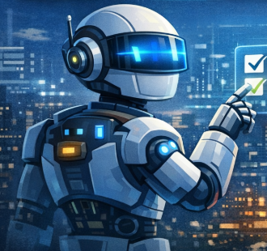
Introduction to Agentic AI
Agentic AI: systems that observe, plan, act, and learn
Data science powers perception, reasoning, and adaptation
Integrated across the full ML workflow
Enables autonomy, reliability, and continuous improvement

Slide 3
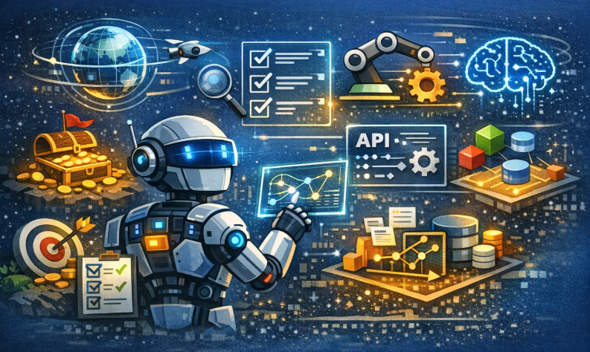
Key Concepts & Terminology
Autonomy Loop: observe → decide → act → learn
World Models: internal environment representations
Reward Modeling: defining and learning objectives
Tool Use: agents calling APIs or external systems
Memory Systems: short‑term + long‑term context

Slide 4
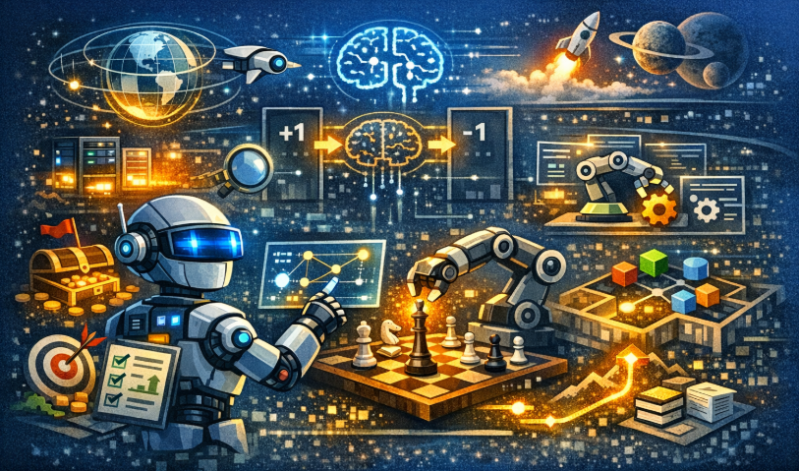
Techniques & Approaches
Real‑time data pipelines and validation
Reinforcement, imittion, and self‑supervised learning
Retrieval‑augmented reasoning
Planning methods: MCTS, model‑based RL
Continuous agent loop for self‑improvement

Slide 5
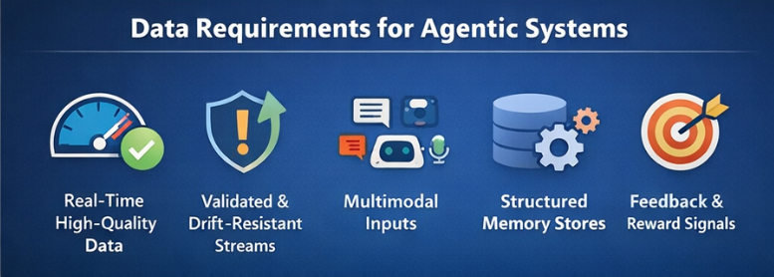
Data Requirements for Agentic Systems
High‑quality, real‑time data for perception and decisions
Validated, consistent, drift‑resistant data streams
Multimodal inputs: text, sensors, logs, embeddings
Structured memory stores for long‑term learning
Feedback signals for reward modeling and improvement

Slide 6
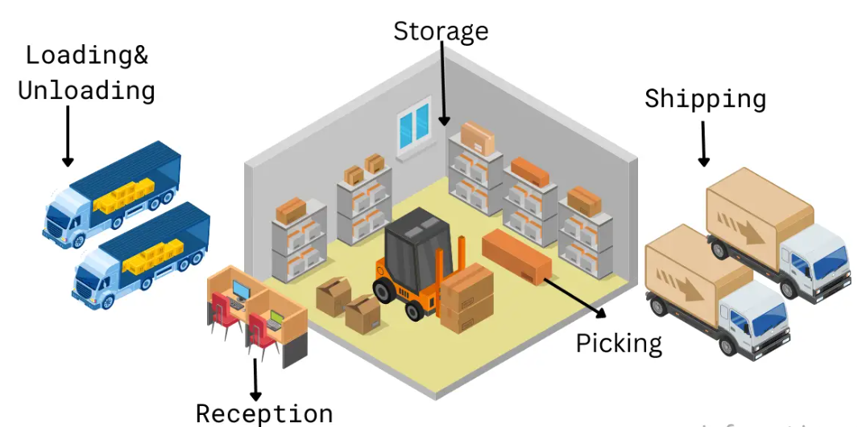
Real‑World Examples
Warehouse robots using RL + sensor fusion
AI assistants using retrieval and tool use
Trading agents optimizing portfolios in real time
Data science ensures stability, safety, and accuracy

Slide 7
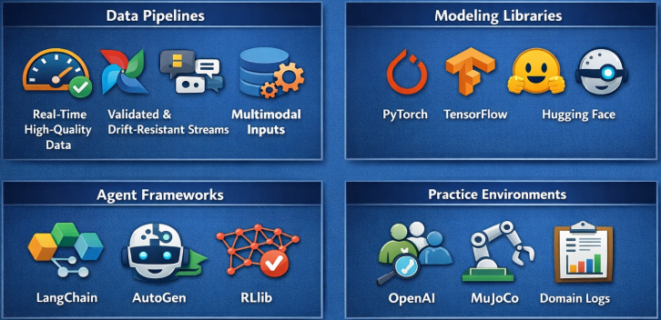
Tools & Platforms
Pipelines: Beam, Airflow, Kafka, Snowflake
Modeling: PyTorch, TensorFlow, Hugging Face
Agent frameworks: LangChain, AutoGen, RLlib
Practice environments: Gym, MuJoCo, domain logs

Slide 8
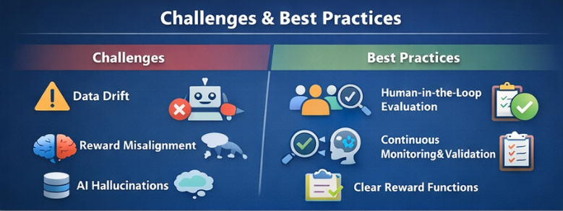
Challenges & Best Practices
Challenges: data drift, reward issues, hallucinations
Safety risks in autonomous decision making
Best practices: human‑in‑the‑loop evaluation
Continuous monitoring and data validation
Clear, interpretable reward functions

Slide 9

Emerging Trends
LLM agents with planning and memory
Self‑improving reflective agents
Differentiable simulators for safe training
Multi‑agent collaboration and negotiation
Neural‑symbolic reasoning hybrids

Slide 10

Visual / Interactive Elements
Autonomy loop diagram
Agent memory + planning workflow
RL training curve animation
Short demo of tool‑using agent

Slide 11

Summary & Takeaways
Data science is the backbone of agentic AI
Strong pipelines and feedback loops enable autonomy
RL, retrieval, and world models drive adaptation
Monitoring and safety are essential
Field evolving toward self‑improving agents

Slide 12
References
Sutton, R. S., & Barto, A. G. (2018). Reinforcement Learning: An Introduction (2nd ed.). MIT Press.
Wang, Y., et al. (2023). Voyager: An Open‑Ended Embodied Agent with LLMs. arXiv:2305.16291.
Shinn, N., Cassano, F., & Gopinath, A. (2023). Reflexion: Language Agents with Verbal Reinforcement Learning. arXiv:2303.11366.
Richards, M., et al. (2023). AutoGPT: An Autonomous GPT‑4 Experiment. GitHub repository.
OpenAI. (2023). GPT‑4 Technical Report. arXiv:2303.08774.
Reed, S., et al. (2022). A Generalist Agent (Gato). Nature, 610, 67–73.
Anthropic. (2024). Model Context Protocol (MCP). Anthropic Research.
Hugging Face. (2023). Transformers Library. GitHub repository.
Microsoft. (2023). AutoGen: Multi‑Agent Framework. GitHub repository.
LangChain. (2023). LangChain Framework. GitHub repository.

